Slide 1

COST
Moments- Frequency Distribution

Slide 2
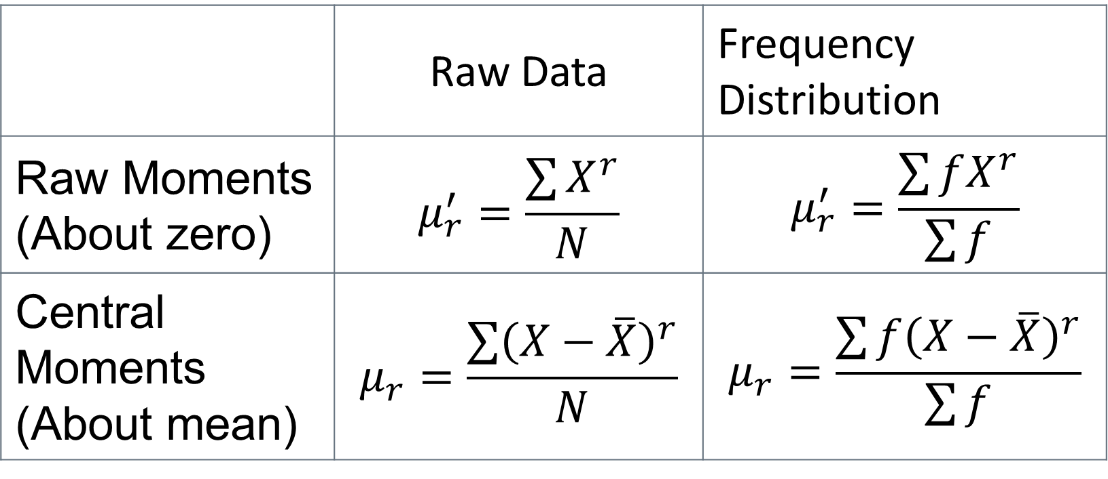
Revision
 | Raw Data | Frequency Distribution
Raw Moments (About zero) | $$μ_{r}^{′}=\frac{\sum{X^{r}}}{N}$$ | $$μ_{r}^{′}=\frac{\sum{fX^{r}}}{\sum{f}}$$
Central Moments (About mean) | $$μ_{r}=\frac{\sum{{\left(X−\overline{X}\right)}^{r}}}{N}$$ | $$μ_{r}=\frac{\sum{{f\left(X−\overline{X}\right)}^{r}}}{\sum{f}}$$

Slide 3

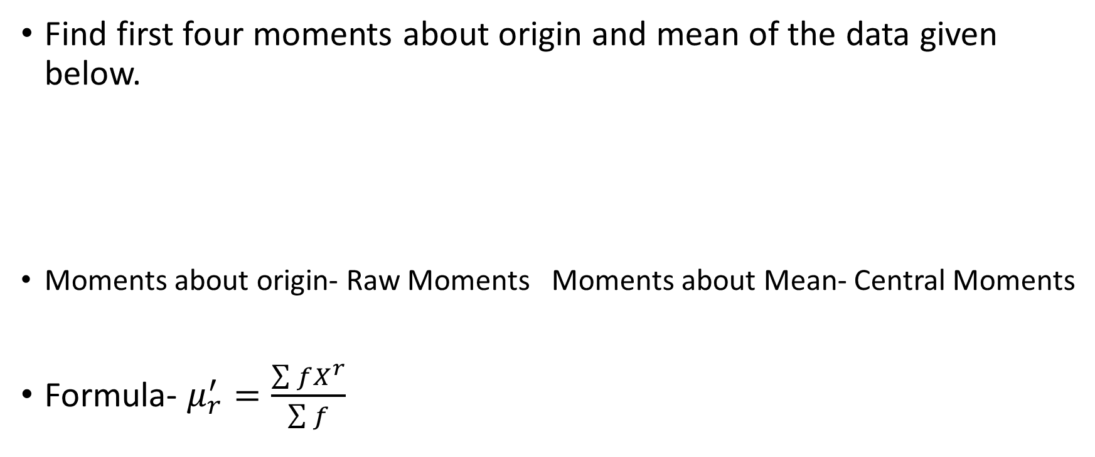
Question
Find first four moments about origin and mean of the data given below.
Moments about origin- Raw Moments Moments about Mean- Central Moments
Formula- $μ_{r}^{′}=\frac{\sum{fX^{r}}}{\sum{f}}$
X | 12 | 14 | 16 | 18 | 20 | 22
f | 1 | 4 | 6 | 10 | 7 | 2
$$μ_{r}=\frac{\sum{{f\left(X−\overline{X}\right)}^{r}}}{\sum{f}}$$

Slide 4
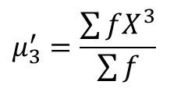
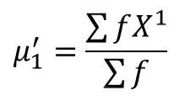
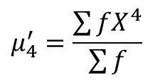
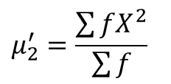
Raw Moments
$$X$$ | f | $$fX^{1}$$ | $$fX^{2}$$ | $$fX^{3}$$ | $$fX^{4}$$
12 | 1 | 12 | 144 | 1728 | 20736
14 | 4 | 56 | 784 | 10976 | 153664
16 | 6 | 96 | 1536 | 24576 | 393216
18 | 10 | 180 | 3240 | 58320 | 1049760
20 | 7 | 140 | 2800 | 56000 | 1120000
22 | 2 | 44 | 968 | 21296 | 468512
 | $\sum{f}$= 30 | $\sum{fX^{1}}$=528 | $\sum{fX^{2}}$= 9472 | $\sum{fX^{3}}$= 172896 | $\sum{fX^{4}}$= 3205888
$$μ_{1}^{′}=\frac{\sum{fX^{1}}}{\sum{f}}$$
$$μ_{2}^{′}=\frac{\sum{fX^{2}}}{\sum{f}}$$
$$μ_{3}^{′}=\frac{\sum{fX^{3}}}{\sum{f}}$$
$$μ_{4}^{′}=\frac{\sum{fX^{4}}}{\sum{f}}$$

Slide 5
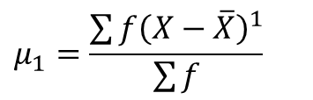
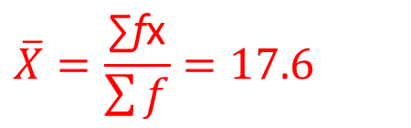
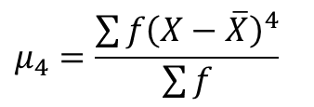
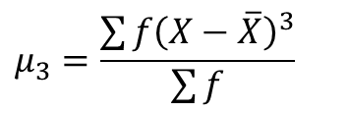
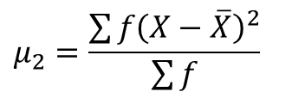
Central Moments
$$\overline{X}=\frac{\text{∑}\text{f}\text{x}}{\sum{f}}=17.6$$
$$μ_{1}=\frac{\sum{f{\left(X−\overline{X}\right)}^{1}}}{\sum{f}}$$
$$μ_{2}=\frac{\sum{{f\left(X−\overline{X}\right)}^{2}}}{\sum{f}}$$
$$μ_{3}=\frac{\sum{f{\left(X−\overline{X}\right)}^{3}}}{\sum{f}}$$
$$μ_{4}=\frac{\sum{f{\left(X−\overline{X}\right)}^{4}}}{\sum{f}}$$
$$X$$ | f | fx | $$\left(X−\overline{X}\right)$$ | $$f{\left(X−\overline{X}\right)}^{1}$$ | $${f\left(X−\overline{X}\right)}^{2}$$ | $$f{\left(X−\overline{X}\right)}^{3}$$ | $$f{\left(X−\overline{X}\right)}^{4}$$
12 | 1 | 12 | -5.6 | -5.6 | 31.36 | -175.616 | 983.4496
14 | 4 | 56 | -3.6 | -14.4 | 51.84 | -186.624 | 671.8464
16 | 6 | 96 | -1.6 | -9.6 | 15.36 | -24.576 | 39.3216
18 | 10 | 180 | 0.4 | 4 | 1.6 | 0.64 | 0.256
20 | 7 | 140 | 2.4 | 16.8 | 40.32 | 96.768 | 232.2432
22 | 2 | 44 | 4.4 | 8.8 | 38.72 | 170.368 | 749.6192
 | $\sum{f}$= 30 | $\sum{fx}$= 528 |  | $\sum{f{\left(X−\overline{X}\right)}^{1}}$= 0 | $\sum{{f\left(X−\overline{X}\right)}^{2}}$= 179.2 | $$\sum{f{\left(X−\overline{X}\right)}^{3}}=$$ - 119.04 | $\sum{f{\left(X−\overline{X}\right)}^{4}}$= 2676.736

Slide 6
Question
Calculate first four raw moments and central moments.
Size | 0-4 | 4-8 | 8-12 | 12-16
Frequency | 10 | 12 | 15 | 13

Slide 7
Skewness
Skewness is a degree of asymmetry/ lack of symmetry/ departure from symmetry.
Concerns with the shape of the curve .
Two types-
Positive Skewness
Negative Skewness

Slide 8
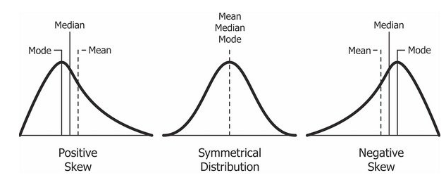
Skewness

Slide 9
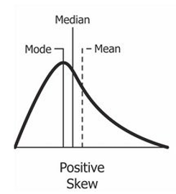
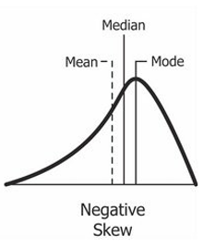
Positive Skewness
Tail on the right side of the distribution is longer.
the mass of the distribution is concentrated on the left of the figure
Mean, Median > mode.
Negative Skewness
Tail of the left side of the distribution is longer.
the mass of the distribution is concentrated on the right of the figure
Mean, Median < Mode

Slide 10

Skewness- Formulae
$Coefficient of skewness= S_{k}$
$S_{k}= \frac{Mean−Mode}{S.D}$ … Pearson’s 1st coefficient of skewness
$S_{k}= \frac{3(Mean−Median)}{σ}$ … Pearson’s 2nd coefficient of skewness

Slide 11
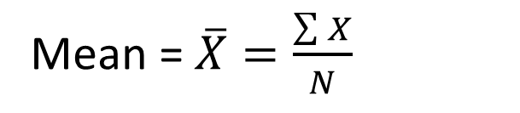
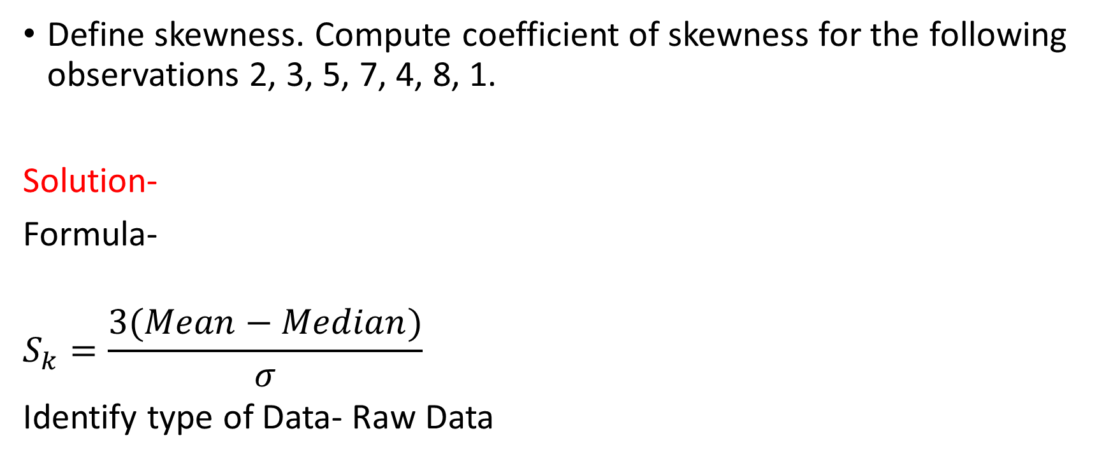
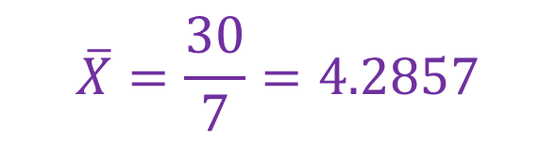
Question Nov 2018
Define skewness. Compute coefficient of skewness for the following observations 2, 3, 5, 7, 4, 8, 1.
Solution-
Formula-
$$S_{k}=\frac{3(Mean−Median)}{σ}$$
Identify type of Data- Raw Data
Mean = $\overline{X}=\frac{\sum{X}}{N}$
$$\overline{X}=\frac{30}{7}=4.2857$$
Median= Middle value of data arranged in increasing order
Median = 4

Slide 12
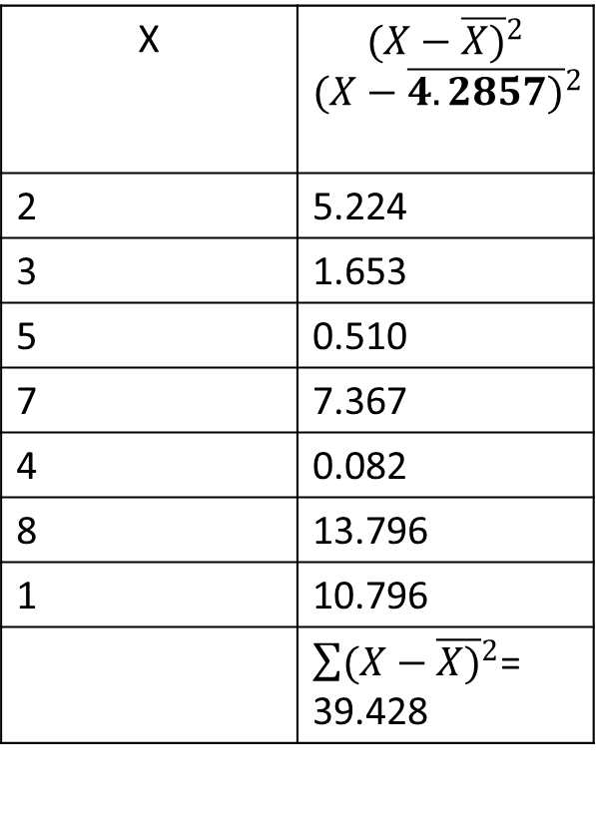



Cont…
X | $${(X−\overline{X)}}^{2}$$ $${(X−\overline{4.2857)}}^{2}$$
2 | 5.224
3 | 1.653
5 | 0.510
7 | 7.367
4 | 0.082
8 | 13.796
1 | 10.796
 | $\sum{{(X−\overline{X)}}^{2}}$= 39.428
$S.D=σ=\sqrt{\frac{\sum{{(X−\overline{X)}}^{2}}}{N}}$
$$σ=\sqrt{\frac{39.428}{7}}=2.373$$
$$S_{k}=\frac{3(Mean−Median)}{σ}$$
$$S_{k}=\frac{3(4.2857−4)}{2.373}$$
$$S_{k}=0.361$$

